Slide 1
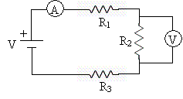
Simple Series Circuits
Series Circuit

Slide 2
Simple Series Circuits
Each device occurs one after the other sequentially or “serially”.
The Christmas light dilemma: If one light goes out all of them go out.
R₁
V
+
R₂
R₃

Slide 3

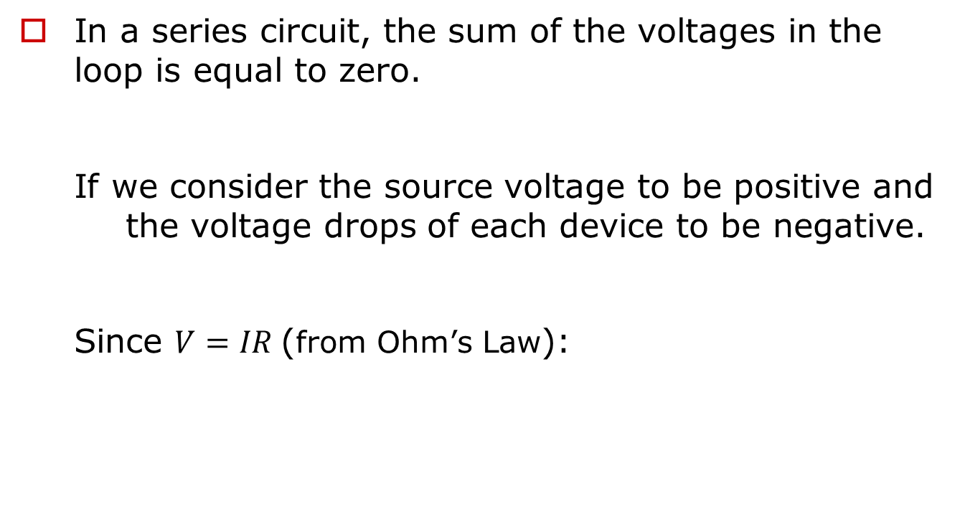



Simple Series Circuit – “Loop Rule” Conservation of Energy
In a series circuit, the sum of the voltages in the loop is equal to zero.
  If we consider the source voltage to be positive and the voltage drops of each device to be negative.
  Since $V=IR$(from Ohm’s Law):
$$Vsource+V1+V2+V3=0$$
$$Vsource−V1−V2−V3=0$$
$$Vsource=V1+V2+V3$$
$$Vsource=I1R1+I2R2+I3R3$$
V₁
V
+
V₂
V₃

Slide 4

Simple Series Circuit - Conservation of Charge
In a series circuit, the same amount of charge passes through each device.
$$IT=I1=I2=I3$$
R₁
V
+
I
R₂
R₃

Slide 5



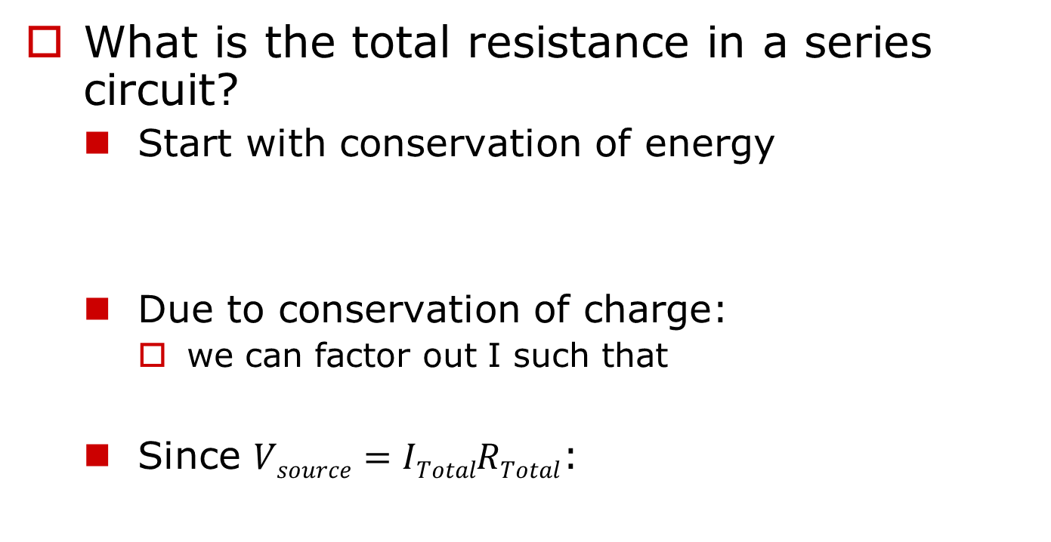



Simple Series Circuit – Determining R_{equivalent}
What is the total resistance in a series circuit?
  Start with conservation of energy
  Due to conservation of charge:
    we can factor out I such that
  Since $Vsource=ITotalRTotal$:
$$Vsource=V1+V2+V3$$
$$Vsource=I1R1+I2R2+I3R3$$
$$ITotal=I1=I2=I3$$
$$Vsource=ITotal(R1+R2+R3)$$
$$ITotalRTotal=ITotal(R1+R2+R3)$$
$$RTotal=REq=R1+R2+R3$$

Slide 6
Example – Simple Series Circuit
A 6, 12 and 30 ohm resistor are connected in series with a 24V battery.
  Determine the equivalent resistance of the circuit.
  Determine the current in the circuit.
  Determine the voltage drop across each resistor.
6Ω
+
24V
12Ω
30Ω

Slide 7



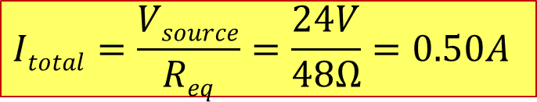

Example – Simple Series Circuit
Find R_{eq} and I
Identify circuit as a series circuit.
  Since you are given the resistance value of each of the resistors first find $REq$.
  Then use Ohm’s Law to determine the current in the circuit
$$REq=R1+R2+R3$$
$$REq=6Ω+12Ω+30Ω=48Ω$$
6Ω
+
24V
12Ω
$$Itotal=\frac{Vsource}{Req}=\frac{24V}{48Ω}=0.50A$$
$$Vsource=ItotalReq$$
30Ω

Slide 8






Example – Simple Series Circuit
Find V_{n}
Since the current is the same for all devices in a series circuit.
  Hence, we can now use Ohm’s Law to solve for the potential drop across each resistor.
  We can verify through the loop rule for conservation of energy that if we add our potential drops together we should get a value equal to the source voltage.
$$ITotal=I1=I2=I3$$
$$V1=IR1=0.50A×6Ω=3V$$
$$V2=IR2=0.50A×12Ω=6V$$
$$V3=IR3=0.50A×30Ω=15V$$
$$Vsource=V1+V2+V3$$
$$Vsource=3V+6V+15V=24V$$

Slide 9
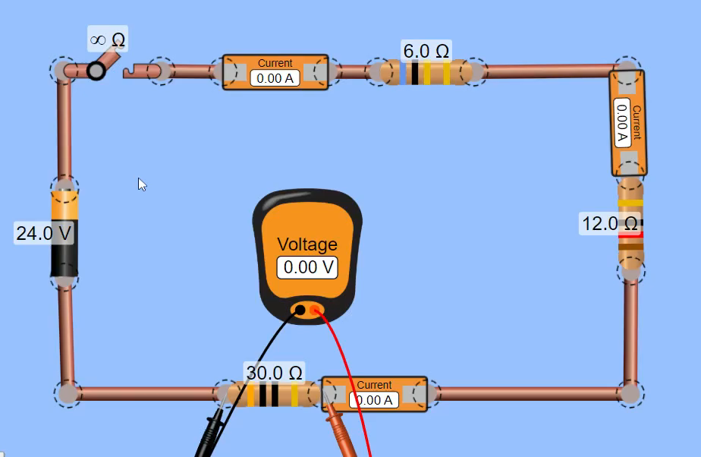
Simple Series Circuit in PHET

